Slide 1
SENTIMENT ANALYSIS
Let’s Start!

Slide 2
Team Members :
20BCY10186
(B. SHIVA SAI)
20BCY10176
(CH. SAI MANEESH)
20BCY10102
(G. SHARAN RAGHAV)
20BCY10087
(ASHUTOSH SHUKLA)
Guide :
Dr. Ashish Ranjan Sir

Slide 3
Introdction
Need of sentimental analysis
Applications
CONTENTS
Approach for sentimental analysis
Implementation and Advantages
Conclusion

Slide 4

What is sentimental analysis
Sentiment analysis is the process of classifying whether a block of text is positive, negative, or, neutral. Sentiment analysis is contextual mining of words which indicates the social sentiment of a brand and also helps the business to determine whether the product which they are manufacturing is going to make a demand in the market or not. The goal which Sentiment analysis tries to gain is to analyze people’s opinion in a way that it can help the businesses expand. It focuses not only on polarity (positive, negative & neutral) but also on emotions (happy, sad, angry, etc.). It uses various Natural Language Processing algorithms such as Rule-based, Automatic, and Hybrid.

Slide 5


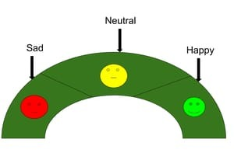
Examples
Users opinions :
Expressions can be classified as positive, negative, or neutral.
“I really like the new design of your website!” → Positive
“I’m not sure if I like the new design” → Neutral
“ The new design is awful!” → Negative
polarity :
♦positive
♦negative
♦complex

Slide 6
Problem Statement of sentimental analysis
The problem in sentiment analysis is classifying the polarity of a given text at the document, sentence, or feature/aspect level.
whether the expressed opinion in a document, a sentence or an entity feature/aspect is positive. negative, or neutral.

Slide 7
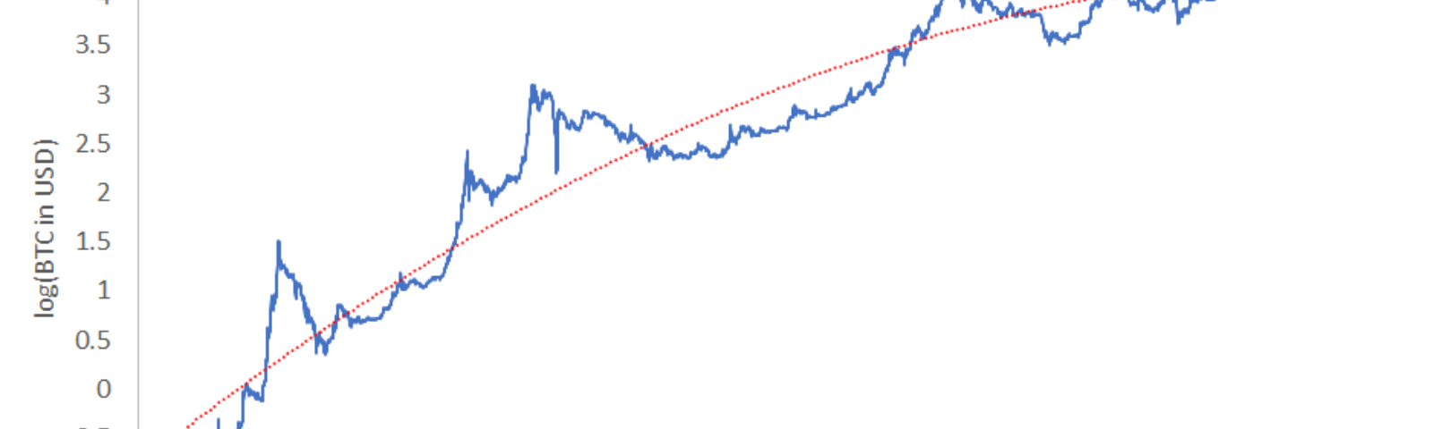
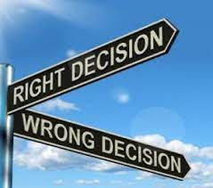
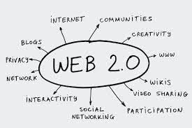
Need of sentimental analysis
Rapid growth of available subjective text on the internet.
WEB 2.0
To Make Decisions

Slide 8
Need of Sentimental Analysis
Sentiment analysis is a powerful marketing tool that enables product managers to understand customer emotions in their marketing campaigns. It is an important factor when it comes to product and brand recognition, customer loyalty, customer satisfaction, advertising and promotion's success, and product acceptance. Understanding the psychology of consumers can help product managers and customer success managers to alter their product roadmap with greater precision. The term emotion-based marketing is a broad umbrella phrase that encompasses emotional customer responses, such as "positive," "negative," "neutral," "negative," "uptight," "disgust," "frustration," and others. Understanding the psychology of customer responses can also increase product and brand recall

Slide 9
applications
Businesses and Organizations:
♦brand analysis
♦new product perception
♦product and service benchmarking
♦business spends a huge amount on of money to find consumer sentiments and opinions
Ads Placements: Placing ads in the user generated content
♦ place an ad when one praises a product
♦ place an ad from a competitor if one criticizes a product
B
A
interested in others opinions:
purchasing a product or using an service
finding an opinions on political topics,movies,etc..
I
S
Social media:
Finding general opinion about recent hot topics in town

Slide 10
approach
Usemantics to understand the language
Uses SentiWordNet
Dont have to understand the meaning
Uses classifiers such as Navive Byes, SVM,etc..
NLP
MACHINE LEARNING

Slide 11

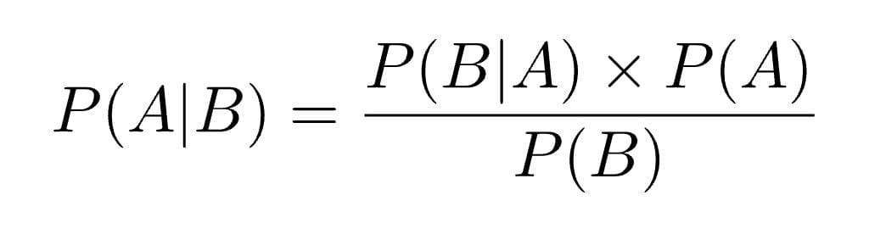
machine learning
There are a number of techniques and complex algorithms used to command and train machines to perform sentiment analysis. There are pros and cons to each. But, used together, they can provide exceptional results.
Naive Bayes
Naive Bayes is a fairly simple group of probabilistic algorithms that, for sentiment analysis classification, assigns a probability that a given word or phrase should be considered positive or negative.

Slide 12
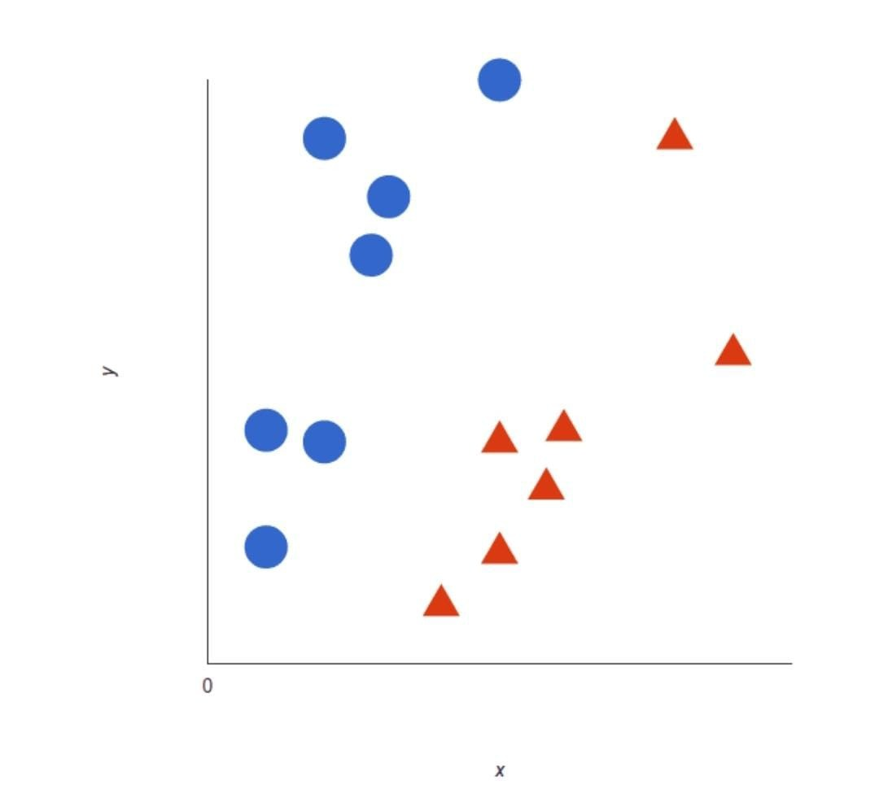
contd..
Support Vector Machines (SVM)
A support vector machine is another supervised machine learning model, similar to linear regression but more advanced. SVM uses algorithms to train and classify text within our sentiment polarity model, taking it a step beyond X/Y prediction.

Slide 13
nlp
Natural language processing is a feild of computer science ,artificial intelligence, and linguistics concerned with the interactions between computers and human languages.
SentiWordNet provides a sentiment polarity values for every term occurring in the document.
Each term t occuring in SentiWordNet is assoicated to three numerical scores obj(t),pos(t), and neg(t).

Slide 14
contd
Akhil: Apple Iphone is a gate phone.It is better than any other phone I have Brought.
Greate = Positives
Better = Positives
Total Positives = 2
Total Negatives = 0
Net score = 2 - 0 = 2

Slide 15
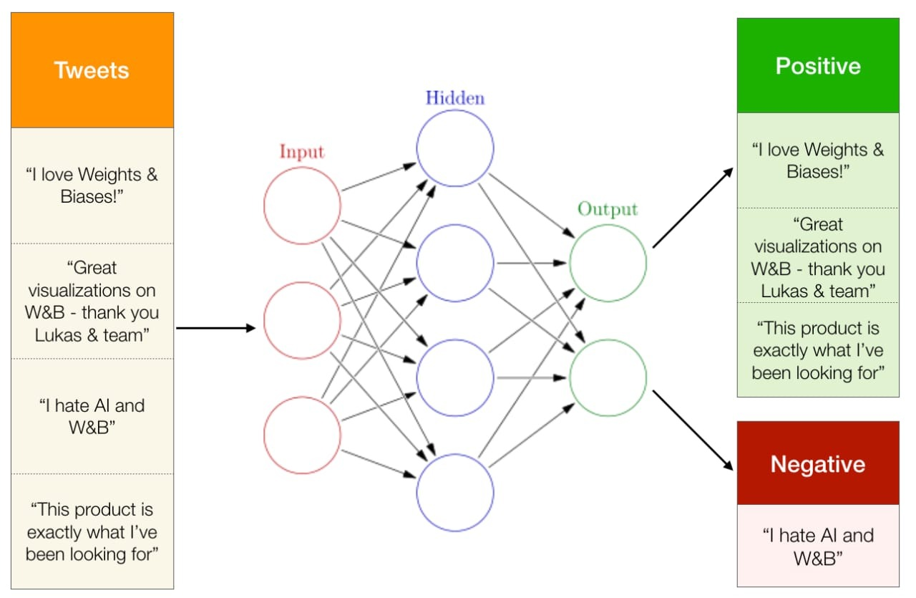
Implementation

Slide 16

Conclusion
The benefits of sentiment analysis and it’s use by business owners help them gain an advantage over their competitors.
Terms like ‘opinion mining’ and ‘text identification’ often describe the meaning of sentiment analysis as a suitable method used by marketers to recognize customers’ preferences.
The data gathered from customers’ responses like tweets, comments, feedback and any writing that’s related to products or services are studied and this process is called sentiment analysis.
Marketers and organizations are pursuing this process to stay relevant in the competitive field and to find a suitable way to advance their business.

Slide 17
As social media plays a significant role in almost every human’s life, most organizations are using it as the communication medium with their customers or other companies.
While companies use social media as a tool to interact with their customers, the comments and feedback derived from the customers are analyzed and used by companies as their guide to improving their products and services.
Let’s look into the benefits of sentiment analysis, the types, and finally what to use sentiment analysis on, further down in this article.
Conclusion

Slide 18
THANKS

